Slide 1
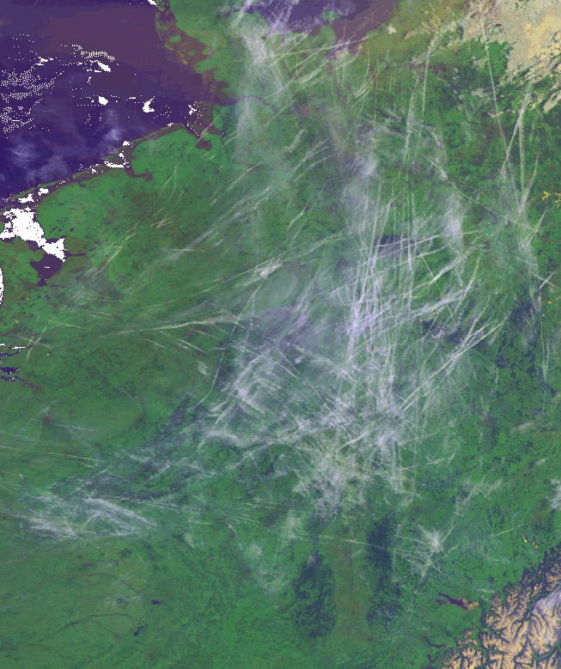
Darwin, Boltzmann, and the Sea of Air First Steps Toward a Theory of Airspace Bruce Sawhill, PhD NextGen AeroSciences, LLC University of California, Santa Cruz

Slide 2
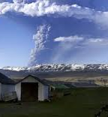
Why a Theory of Airspace?
Coping with novel situations: Principled extrapolation
Results not dependent on specific details (air routes, etc)
Adaptability, short- and long-term
Growth path:
More traffic, divergent performance, more O/Ds, UASs

Slide 3
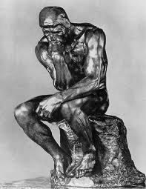
Why Darwin and Boltzmann?
Both developed theories for complex systems
Darwin wanted to understand the patterns of biological diversity (inhomogeneous)
Boltzmann wanted to understand the regularities of systems with large numbers of similar elements (homogeneous)
Airspace needs a statistical mechanics of inhomogeneous systems

Slide 4

Misguided Optimization
b ➔ b-1
“Premature optimization is the root of all evil.”- D. Knuth

Slide 5
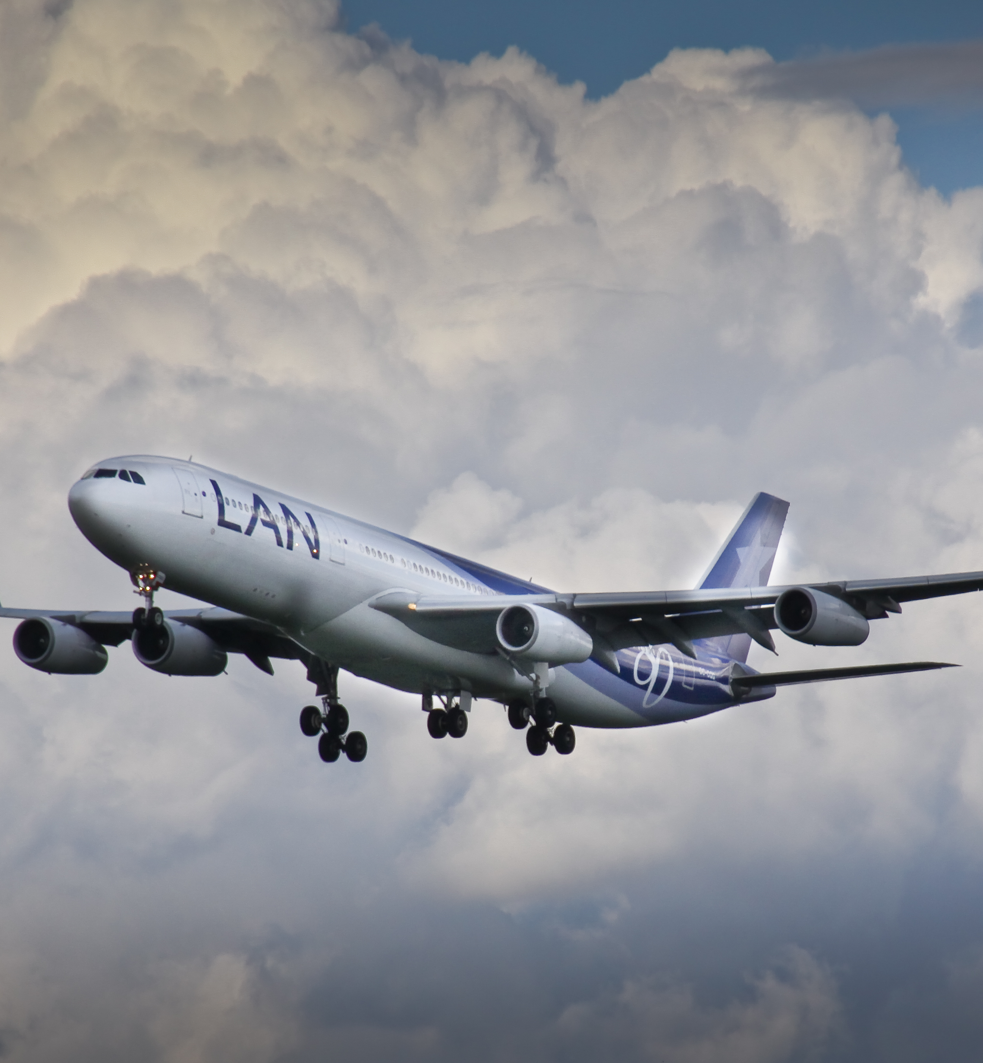
Why we might care
There is no “general theory” of airspace
Status quo is reaching limits of functionality
Can’t extrapolate forever
The world’s largest machine
“A system or device for doing work, such as an automobile or a jackhammer, together with its power source and auxiliary equipment.”

Slide 6
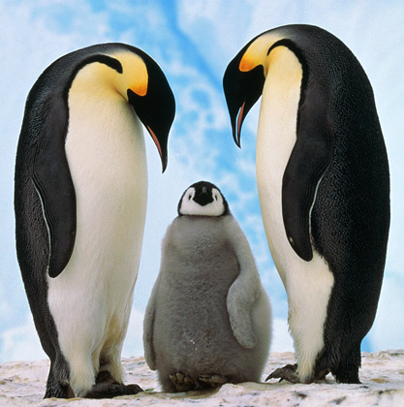
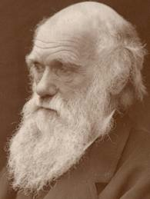
Darwin’s Legacy
Evolution is driven by variation and selection
Variation explores the space of possibilities
Selection chooses from the possibilities
Fitness depends on everyone else
How well you do is context dependent
An organism needs a whole ecosystem
Recursive definition: Keep on keeping on

Slide 7
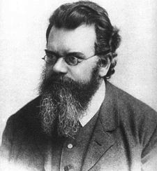
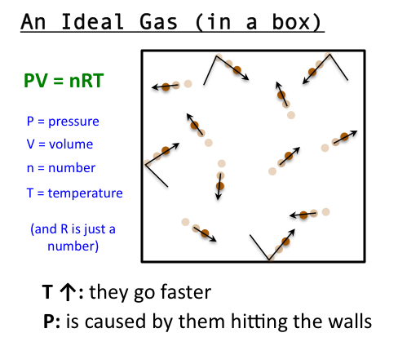
Boltzmann’s Legacy
A statistical approach to nature
Understanding the world gets easier, not harder, when the numbers get bigger
Bulk properties independent of details: Ideal Gas Law:
pV = nRT
Microscopic laws imposed from outside
Newton’s Laws

Slide 8
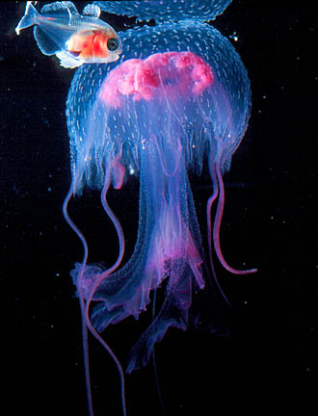
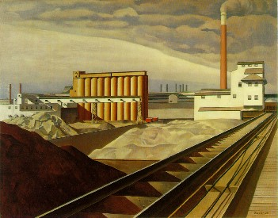
Observations on Evolved and Engineered Systems
Physics has traditionally led the sciences in the application of analytic methods
The Boltzmann paradigm has dominated the field of systems with many moving parts because of its spectacular early success
The analytics used by Boltzmann apply to systems that are “most likely = equilibrium”
Evolved and engineered systems are “highly non-random = highly unlikely” because their endogenous or exogenous purpose has driven them to a very particular corner of configuration space
Context matters!
EE Systems have agency/optimization
Want rigor of physics applied to a system with intent

Slide 9
Agency and Optimization Paradigms Lost
Darwin:
Agency:
Survival of the fittest: Use everything you’ve got to get everything you can get
Optimization Issues: What is being optimized?
The Unit of Selection problem
No insight for systemic properties: shifting mosaic, tangled bank
Boltzmann
Optimization: Maximum entropy principle
Lack of Agency:
Particles are indistinguishable in time and space
They all obey exactly the same rules (conservation of E,p)
No notion of context
No notion of intent

Slide 10
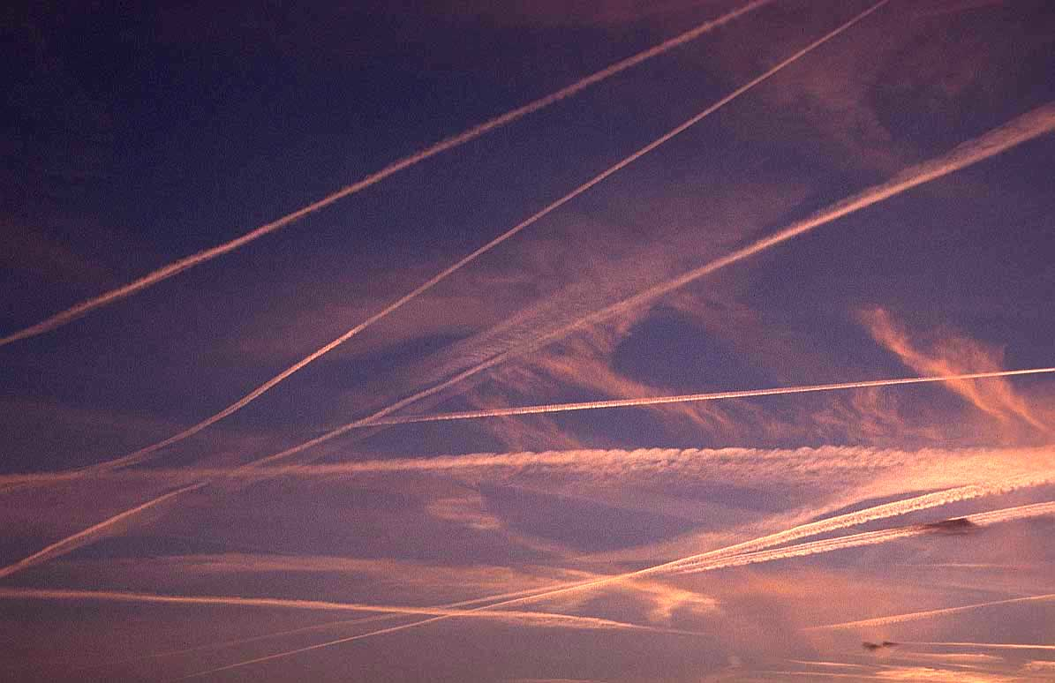
Agency and Optimization: connecting the airspace to Boltzmann and Darwin
Agency
A means by which intelligence achieves a result
Distinguishable from other agents (unlike ideal gas)
A good framework for self-propelled entities
If an agent can act on its own behalf, it can seek to improve its utility/fitness
Optimization
Extremum principle (entropy, cost, time)
Competing constraints
A theory of airspace must involve both agency and optimization

Slide 11
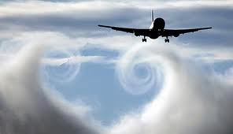
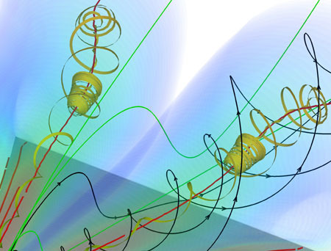
Emergence in Classical Physics “strong” prediction
CFD example
Well understood microscopic laws
Newton➔Navier-Stokes
Iterated solution yields a surprise
“Surprise” is a moving target

Slide 12
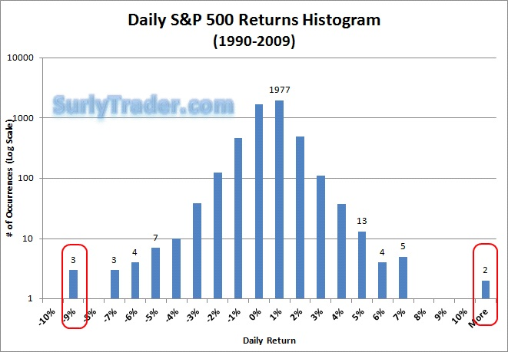
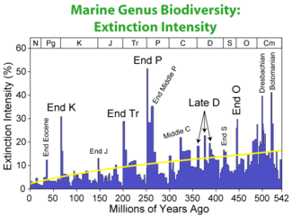
Emergence in Ecology and Economics “weak” prediction, agency
Species extinction record
Stock market fluctuations
Perhaps a better paradigm for an airspace theory- systemic efficiency and safety

Slide 13
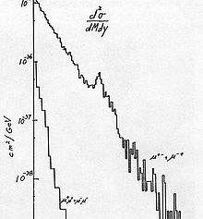
Engineering Philosphy: S/N Ratio
All engineered systems encode intent
This is the “signal”
All engineered systems have uncertainty
This is the “noise”
Most common strategy: Reduce noise
Second stategy: Failing #1, wait a long time

Slide 14
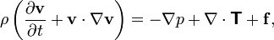
An aviation example
It is now possible (SESAR, Honeywell) to hit 4DT waypoints very accurately (2s)
Windfield accuracy +/- ~6 m/s over USA (.02 Mach)
Problem: Windfield uncertainty accumulates to size of separation criteria in 15-20 minutes.
Approach 1: Reduce windfield uncertainty
Achieving a factor of n here requires a great investment in data and computation
Data pts. scale as n⁶
Approach 2: Hit the waypoints anyway. Being off .02 Mach can be significant for fuel. “One less bump”
Approach 3: Dynamically replan

Slide 15
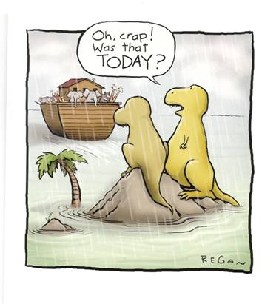
The benefits of dynamic replanning

Slide 16

The ‘Sea’ of Air

Slide 17
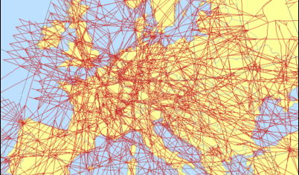
The Sea of Air?

Slide 18
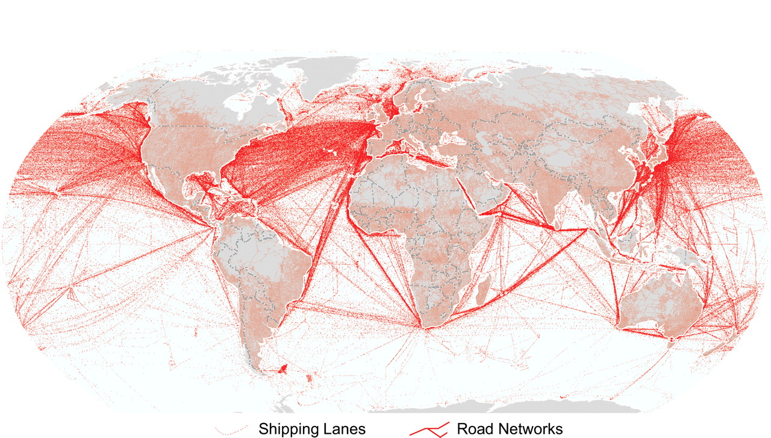
The Sea: World Shipping Lanes

Slide 19

Underneath, A 3D world

Slide 20

An exercise of simplification
Currently
Air
Aircraft
VORs
Sectors
Classes of airspace
Jet routes
Controllers
Ground
Local
En route
TRACON
etc
What if there were only 3 things?
Air
Aircraft
Airports

Slide 21

Desiderata
We’d like a NAS (or WAS) that is
Safe (10⁻⁹ incidents/hr or better)
Efficient (like it was all mine)
Low maintenance (current n^2
problem)
Robust (details don’t matter)
Adaptive
Long term: Upwardly compatible
Short term: Market forces
Looks more like the IT world (OS metaphor)
Has an underlying theory

Slide 22
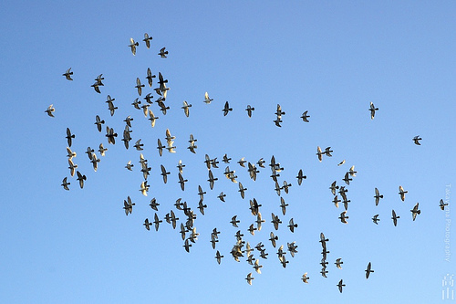
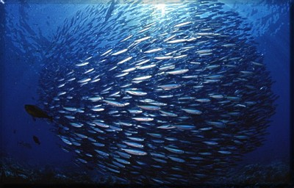
Look to Nature for inspiration
Living systems cope with decision complexity
Utilizing autonomous and distributed decision making
Aligning individual goals with system goals
Operating in a noisy and uncertain environment
Readily scalable

Slide 23


Are natural patterns relevant?

Slide 24
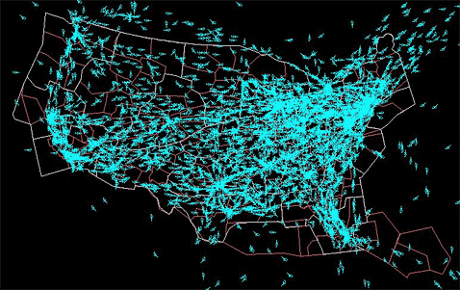
“Traffic Physics”
A new field designed to apply statistical mechanics to “smart particles = agents”
“laws of motion” are a subset of physical laws
Notion of intent
Understanding road traffic
Characterizing bulk properties for mitigation and control
Implications
“Up-level” control
Share, reduce the workload
Robustness (phase not dependent on individual conflict)
Efficiency

Slide 25
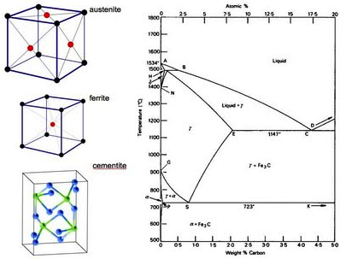
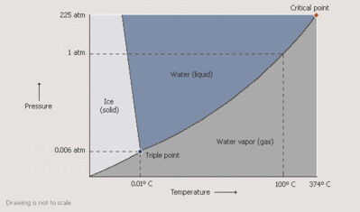
Statistical Physics: Characterizing bulk properties of interacting elements
The idea of “phase”
Applies to equilibrium physical systems
Coarse and fine structure

Slide 26
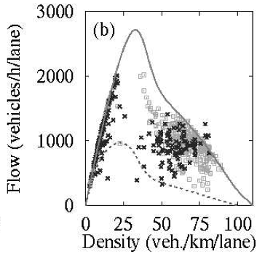
Helbing Traffic Model (2003)
Phase 1:Smooth Flow
Phase 2: Jammed Traffic
Simplified vehicle dynamics
Single parameter of control
Exactly soluble limiting cases
Easy 1-D incorporation of intent

Slide 27
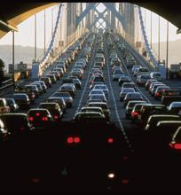
Traffic Physics Applied
San Francisco Smarter Traveler Research Initiative (May 2011)
Joint Project of
IBM
CADOT
California Center for Innovative Transportation (UCB)
Data Sources
Smartphone GPS
Inductive Loops in roadways
Results
Jam prediction
Alternate Route Suggestion
Delivery
SMS, email

Slide 28
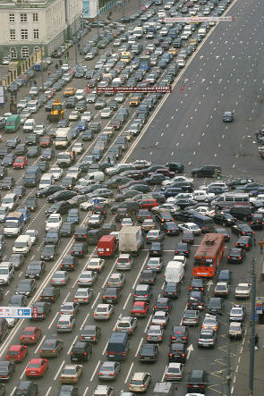
Emergent Phenomena
Road traffic
Jammed
Free flowing
Surges
Backward waves
Can have many phases
Air traffic
Emergent properties: Tromboning, ground holds, holding patterns
Build a model with few constraints
“CFD for the NAS”
Use computation to Grow/optimize instead of design
Durand,
Alliot

Slide 29
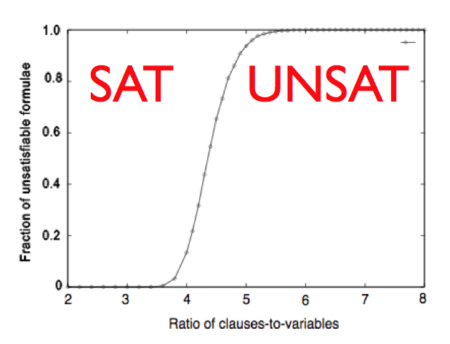
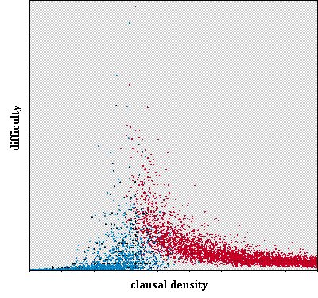
SAT Phase Transition
L. Snell
Kirkpatrick & Selman (94) – NP Problem Equivalence
A system near a phase boundary will have observable consequences to its agents
More controlling actions
More complex decision logic
”Don’t fly faster than your angels”-when matters, not just what
“Tremble your lid before flipping it”- early warning desired
“Hot airspace”—something new to monitor and control
DayJet schedule example of logic phase transition

Slide 30
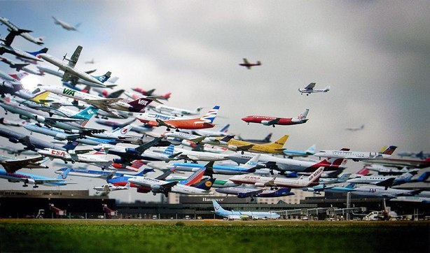
Benefits of Prediction/Replanning

Slide 31
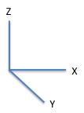
“String Theory” of Flight
Represent Trajectory as Extended Object
Constrained at end points, contains intent (direction vector not good enough for optimization)
Object aligned with cost functions used to evaluate performance
Strings repel each other with navigation functions
Fast to compute, particularly in parallel
Repulsion balances “tension” from optimization
Constrained (curvature, etc) by flight physics, operational guidelines (don’t spill the coffee)
Phase transitions known to exist (Hagedorn, 1965)

Slide 32
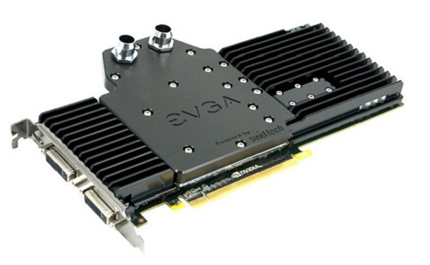
An Experimental “Apparatus”
NVIDIA GPU card(s) in a PC
Up to 1500 processors, 2 teraflops
Cost: About $2 per gigaflop
About 2000 times cheaper than yr. 2000 per flop
10¹² times cheaper per flop than 1960
On handheld in cockpit in 2020?
We believe it is possible to simulate entire enroute airspace in >> real time, realistically including:
Wx
Deconfliction
Uncertainty

Slide 33
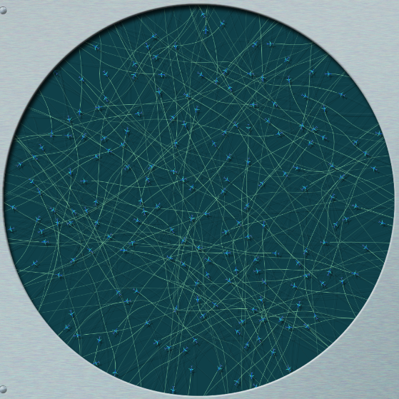
5DT in TBO Airspace
En Route Test Jig
Aircraft
Entry-Exit
Trajectory history
Trajectory future
Altitude
Constraints
Separation
Business case proxy
Flight physics
Dynamics
Continuous replan
Maneuvering
About 5DT
“The future ain’t what it used to be”- Yogi Berra

Slide 34
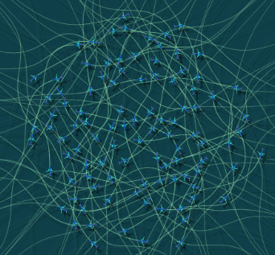
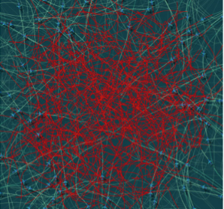
Increasing Density of Trajectories Causes Loss of Flexibility and Emergence of Traffic Physics Phase Transition from Conflict-Free to Conflicted TBO Airspace: Trajectory A to Z becomes Trajectory A to B becomes A becomes {0}
Conflict-Free Airspace
Conflicted Airspace
© 2011 NextGen AeroSciences, LLC. All Rights Reserved
Increasing Density of Trajectories

Slide 35
Show movies

Slide 36
Airspace Phases
Conflict-Free Airspace
Conflicted Airspace
© 2011 NextGen AeroSciences, LLC. All Rights Reserved

Slide 37
Controlling Airspace Phase State With Bulk Properties (Separation)
Conflict-Free
Airspace
Conflicted
Airspace
Phase Boundary
(with changing separation)
Trajectory Density

Slide 38

Reprise
We have embarked upon a scouting
mission
Adventures go better with a map and
compass
Theory provides these
“On the shoulders of giants” - Newton
This audience is comprised of candidate explorers
What might one expect to encounter if you look far afield?
A highly political, bureaucratic, mature field: Hindrance or Opportunity?
Darwin, Boltzmann, and others are your guides on this Sea of Air
New ideas are “merely” the combinatorics of old ones, with randomness (variation and selection)
It is time for a new philosophy of engineering
Notes:
Here’s some questions that provoked the path we are taking.

Slide 39
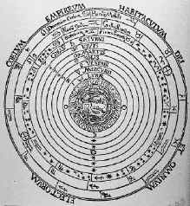
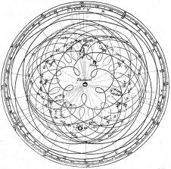
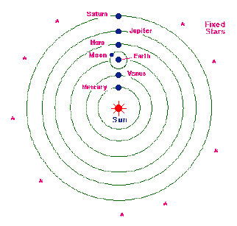
Postscript on the nature of revolution

Slide 40
Thank you
Dr. Bruce K Sawhill
Team:
Dr. Jim Herriot
Dr. Bruce J Holmes
Ken Seehart
William Van Valkenberg

